Slide 1
On-line Construction of
Suffix Tree
Esko Ukkonen
Algorithmica Vol. 14, No. 3,
pp. 249-260, 1995

Slide 2
Abstract
An on-line algorithm is presented for constructing the suffix tree for a given string in time linear in the length of the string. The new algorithm has the desirable property of processing the string symbol by symbol from left to right. It has always the suffix tree for the scanned part of the string ready. The method is developed as a linear-time version of a very simple algorithm for (quadratic size) suffix tries.

Slide 3
Abstract
Regardless of its quadratic worst-case this latter algorithm can be a good practical method when the string is not too long. Another variation of this method is shown to give in a natural way the well-known algorithms for constructing suffix automata (DAWGs).

Slide 4
Suffix Trie for (cacao)
Σ
o
c
a
a
o
c
c
o
a
a
o
o

Slide 5
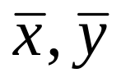
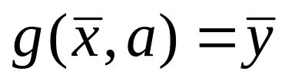

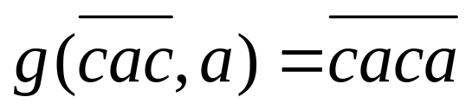
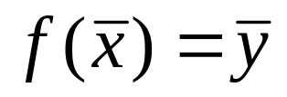
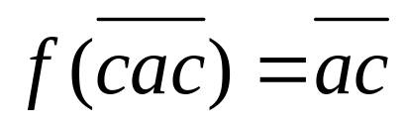
T = t₁t₂…t_{n} is a string over an alphabet Σ.
x , y are substrings of T.
are states that corresponds to x , y.
Transition function :
for all such that y = xa.
where .
ex:
Suffix function:
if x=ay for some a.
ex:

Slide 6
Construction of STrie(cacao)
Σ
o
c
a
a
o
c
c
o
a
a
o
o

Slide 7
Construction of STree(cacao)
Σ
Σ
Σ
Σ
c
ca
a
cac
ac
Σ
Σ
caca
aca
ca
o
a
cao
o
cao
o

Slide 8
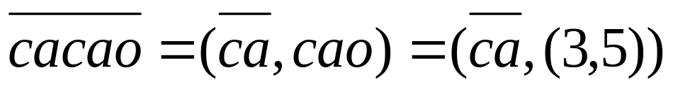
States:
Branching state (at least two transitions)
Leaf (no transition)
Implicit state (exactly one transition)
Reference pair:
r = (s , w) where s is some explicit state that is an ancestor of r and w is the string from s to r.
w = (k , p) such that t_{k}…t_{p} = w
ex:

Slide 9
Two Kinds of State to Add
(i) Leaves get a transition
  Update (s, (k, i-1)) to (s, (k, i)) .
  (s, (k, ∞ )) instead.
(ii) New branches
  Active point : First state that is not a leaf.
  End point : First state that has a t_{i}-transition.

Slide 10
Lemma
Let (s, (k, i-1)) be a reference pair of the end point of STree(T^{i-1}). Then (s, (k, i)) is a reference pair of the active point of STree(T^{i}).

Slide 11
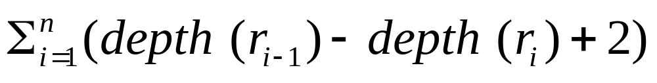
Complexity
Let r_{i} be the active point of STree(T^{i}).
The number of the visited states between r_{i-1} and r_{i} are depth(r_{i-1}) - depth(r_{i}) + 2.
The total number of the visited states are
= depth(r₀) - depth(r_{n}) +2n ≦ 2n

